Slide 1
No quiz today!
Ethics in Human-AI interaction

Slide 2
Before we begin: announcements
The readings are up -- take it easy!
They are due this Sunday 11:59pm, not Thursday, because we don’t have class on Thursday (so we don’t need them to prep for class.)
The fairness quiz is on Tuesday.
No scheduled office hours this week for me; happy to schedule a 1:1 with you.
Again, no class on Thursday.

Slide 3
Learning objectives
You should be able to:
Distinguish between distributional justice and procedural justice
Distinguish between a machine learning algorithm’s confidence and its goodness (e.g. accuracy)
Describe challenges with distributional justice with an “inscrutable” algorithm
Describe generally one way to address it, and its shortcomings
Justify why it’s necessary to think of humans in the loop while thinking of AI fairness

Slide 4
An example of distributive justice
Outcomes (both benefits and costs) should be unbiased with regard to race, gender, and other sensitive attributes.
Deals with who gets what. (cf. utilitarian models of ethics)

Slide 5
An example of procedural fairness
Decisions must be:
Accurate
Fair
Consistent
Correctable
… (and other requirements)
Deals with who gets how. (cf deontological models)

Slide 6
Procedural fairness leads to new AI requirements
Decisions must be:
Accurate
how do you deal with data unlike your training data? (credit scores for immigrants)
Fair
the same outcome may be unfair (e.g. should you get extra late days on your assignment if your dog died?)
Consistent
can a small change in your input lead to large differences in output?
Correctable
What is our appeals process? Who/what decides the outcomes of the Final Appeal?

Slide 7
Learning objectives
You should be able to:
Distinguish between distributional justice and procedural justice
Distinguish between a machine learning algorithm’s confidence and its goodness (e.g. accuracy)
Describe challenges with distributional justice with an “inscrutable” algorithm
Describe generally one way to address it
Justify why it’s necessary to think of humans in the loop while thinking of AI fairness

Slide 8
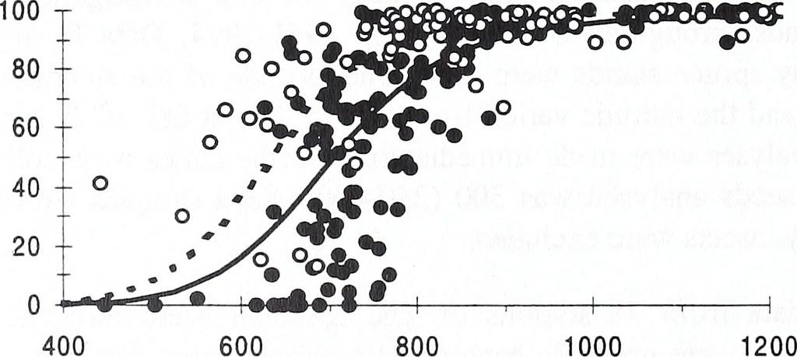

Slide 10
Filled class
Filled/total = ?
Unfilled/total = ?

Slide 11
Unfilled class
Filled/total = ?
Unfilled/total = ?
Filled class
Filled/total = ?
Unfilled/total = ?

Slide 12
Unfilled class
Filled/total = ?
Unfilled/total = ?
Accuracy?
(unfilledTop + filledBottom)/totalBoth
Filled class
Filled/total = ?
Unfilled/total = ?

Slide 13
Very confident prediction

Slide 14
Not confident prediction

Slide 15
Unfilled class

Slide 16
Filled class
Unfilled class

Slide 17
Confidence
Unfilled class

Slide 18
High confidence
Low
confidence
Low confidence
High confidence

Slide 19
High confidence
Low
confidence
Low confidence
High confidence
Very confident,
But still wrong

Slide 20
Some takeaways
You can be very confident and still wrong
Confidence is related to inputs, not outputs
High confidence can mean:
Very likely in real life
Error in model
Validation sets are an attempt to make confidence reflect reality
A perfectly-calibrated model is one where confidence == prediction accuracy for that input

Slide 21
Calibration errors are real errors
A weather model says “It will rain today with 80% confidence”
Classifies a discrete event “rain”
Confidence of rain today = 80%
In a well-calibrated model:
If confidence is 80%, 4 of 5 days where it says it will rain experience rain
Can be expressed as “there is an 80% chance of rain today”
In a badly-calibrated model:
If confidence is 80%, maybe only 1 in 5 days does it rain (or maybe it rains 4.9 of 5 days!)
Badly calibrated model can be accurate!
E.g. if all events that happen have a confidence of 51%, all events that don’t have confidence of 49%.

Slide 22
Calibration errors are real errors
A weather model says “It will rain today with 80% confidence”
Classifies a discrete event “rain”
Confidence of rain today = 80%
In a well-calibrated model:
If confidence is 80%, 4 of 5 days where it says it will rain experience rain
Can be expressed as “there is an 80% chance of rain today”
In a badly-calibrated model:
If confidence is 80%, maybe only 1 in 5 days does it rain (or maybe it rains 4.9 of 5 days!)
Badly calibrated model can be accurate!
E.g. if all events that happen have a confidence of 51%, all events that don’t have confidence of 49%.
No one trusts a weather service which tells you it is always 51% confident!

Slide 23
Learning objectives
You should be able to:
Distinguish between distributional justice and procedural justice
Distinguish between a machine learning algorithm’s confidence and its goodness (e.g. accuracy)
Describe challenges with distributional justice with an “inscrutable” algorithm
Describe generally one way to address it, and its shortcomings
Justify why it’s necessary to think of humans in the loop while thinking of AI fairness

Slide 24
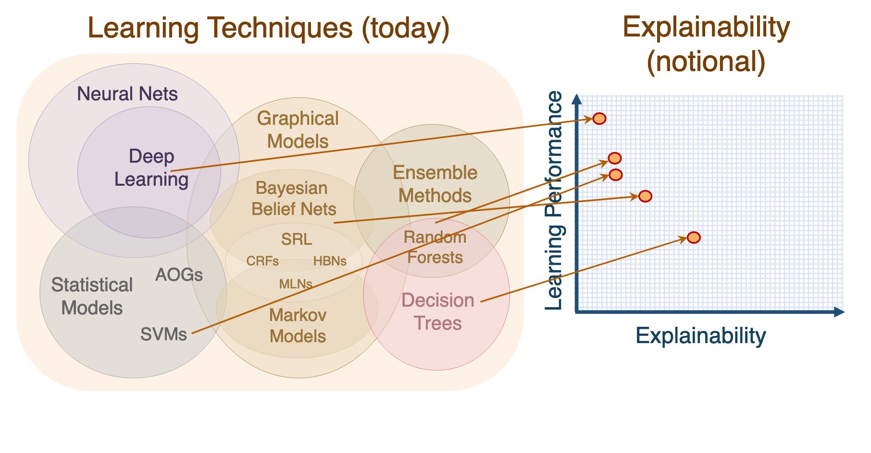
The inscrutables
Notes:
https://www.darpa.mil/attachments/XAIProgramUpdate.pdf

Slide 25
The inscrutables: usually explainability is in terms of decomposability rather than simulability
Notes:
https://www.darpa.mil/attachments/XAIProgramUpdate.pdf

Slide 26
Advice-giving AI
Real world
AI model
Human judge
decides
/affects
advices

Slide 27
Advice-giving AI: where might bias creep in?
Real world
AI model
Human judge
decides
/affects
advices

Slide 28
Advice-giving AI: *how* might bias creep in?
training
Real world
AI model
Human judge
decides
/affects
??
advices
interrogates/ feedback
observes

Slide 29
Advice-giving AI: one bad scenario
Training encodes bias
Real world
AI model
Human judge
biases
?? chosen to be convenient, not useful
ignores
Trusts blindly
justifies

Slide 30
Why bother with explanations/interpretations?
Algorithms can be wrong on examples that human operators get right
Algorithms can be working on outdated data (and have no way to handle “distributional drift”)
Explainable algorithms can further science
People are happier if they feel like they know what’s going on (even if they can’t control it)

Slide 31
But we need to do more
Reading 1: Consider questions of procedural and distributive justice in each decision
Design with the mind in mind
Reading 2: Think carefully about what becomes infrastructure -- it shapes us, and it’s also invisible.
Optional reading: Technical approaches to inspect algorithms may also help

